Slide 1

Agent Activity Chart
1/12/2023 11:52 PM
Print User : automation
Page 1 of 3

Slide 2
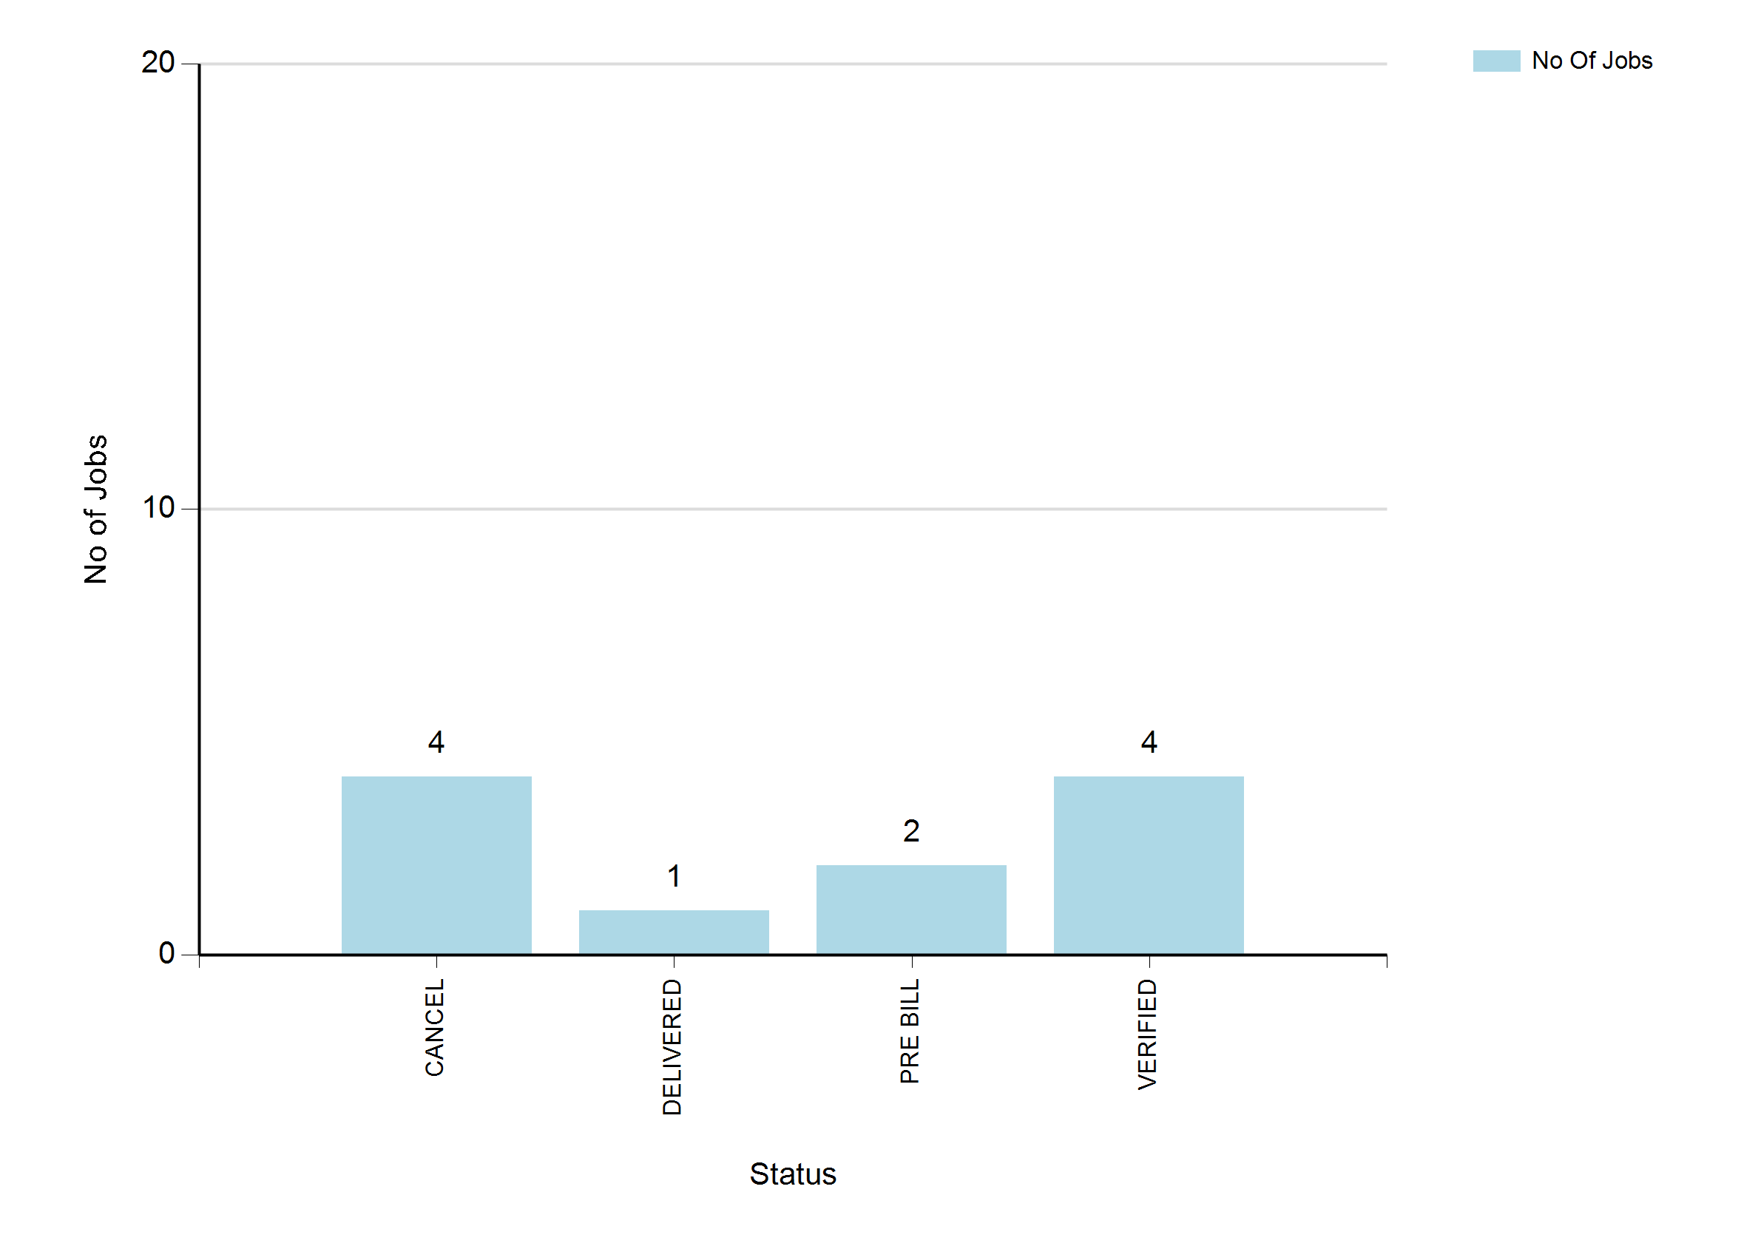
1/12/2023 11:52 PM
Print User : automation
Page 2 of 3

Slide 3
1/12/2023 11:52 PM
Print User : automation
Page 3 of 3

